Slide 1

Global Video Games Sales Analysis Dashboard
This project analyzes global video game sales performance
using an interactive Power BI dashboard.
Tool Used: Microsoft Power BI
by: SathishKumar A

Slide 2

Problem Statement
•The global video game industry generates vast amounts of sales data across multiple genres, platforms, and years.
•Analyzing this data using traditional methods is time-consuming and inefficient.
•Stakeholders face difficulty in:
•Identifying top-performing genres and platforms
•Tracking revenue and units sold trends over time
•Comparing performance across different market
•There is a need for a centralized, interactive dashboard
to analyze video game sales effectively.

Slide 3

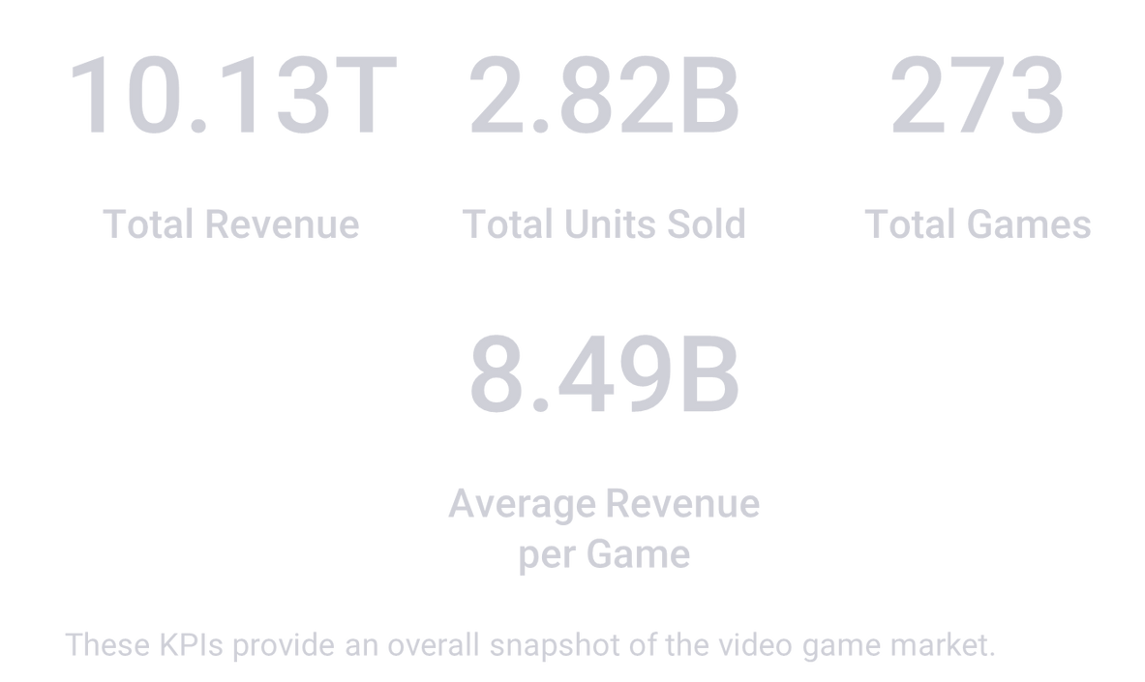
Key Performance Indicators (KPIs)
The top section of the dashboard displays summary KPIs:

Slide 4
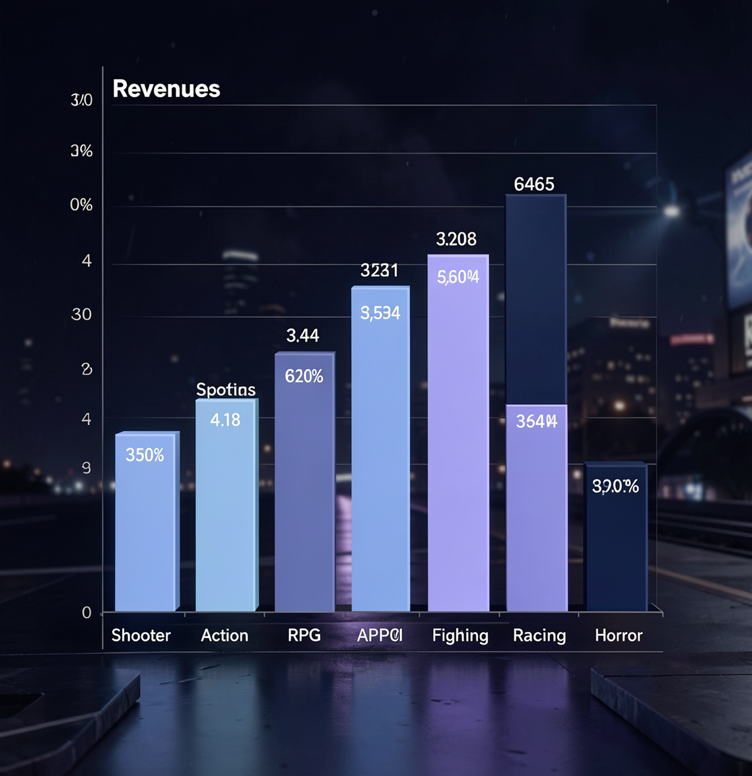
Revenue by Genre
•Shooter genre generates the highest revenue.
•Action-Adventure and Sports genres also
perform strongly.
•RPG and Fighting genres show moderate
contribution.
•Racing and Horror genres generate lower
revenue.
👉 Helps identify the most profitable game genres.

Slide 5

Revenue by Platform
•Revenue is distributed across multiple
platforms:
◦PlayStation (PS4, PS5)
◦Xbox (Series X, Xbox One)
◦PC
◦Nintendo Switch
•Platform performance is well balanced.
•Highlights importance of multi-platform
releases.

Slide 6




Sales Performance Insights

Slide 7

Conclusion
•Power BI effectively visualizes global video game sales data.
•The dashboard combines KPIs, trends, and comparisons.
•Interactive filters enhance analytical flexibility.
•This project demonstrates strong data visualization and business analytics skills.

